Slide 1
Get ready and prepare
English Years 0-6 and mathematics & statistics Years 0-8 implementation 2025

Slide 2

Te Mātaiaho
Mātai aho tāhūnui, Mātai aho tāhūroa, Hei takapau wānanga E hora nei. Lay the kaupapa down And sustain it, The learning here Laid out before us.
Notes:
Karakia

Slide 3


See how the revised learning areas inform what to teach, when to teach, and how, based on the science of learning which provides teachers with effective teaching strategies and practices.
Supporting school leaders and teachers to understand and plan for English Years 0-6 and mathematics and statistics Years 0-8 learning areas by:
Noticing the key updates in the English Years 0-6 and mathematics and statistics Years 0-8 learning areas
Recognising how the science of learning and knowledge-rich approaches are woven together to support student learning
Responding by weaving together the progress outcome - UKD elements and applying evidence-based practices
Notes:
Aim:
Noticing the key updates in the English Years 0-6 and mathematics and statistics Years 0-8 learning areas
Recognising how the science of learning and knowledge-rich approaches are woven together to support student learning
Responding by weaving together the progress outcome - UKD elements and applying evidence-based practices

Slide 4
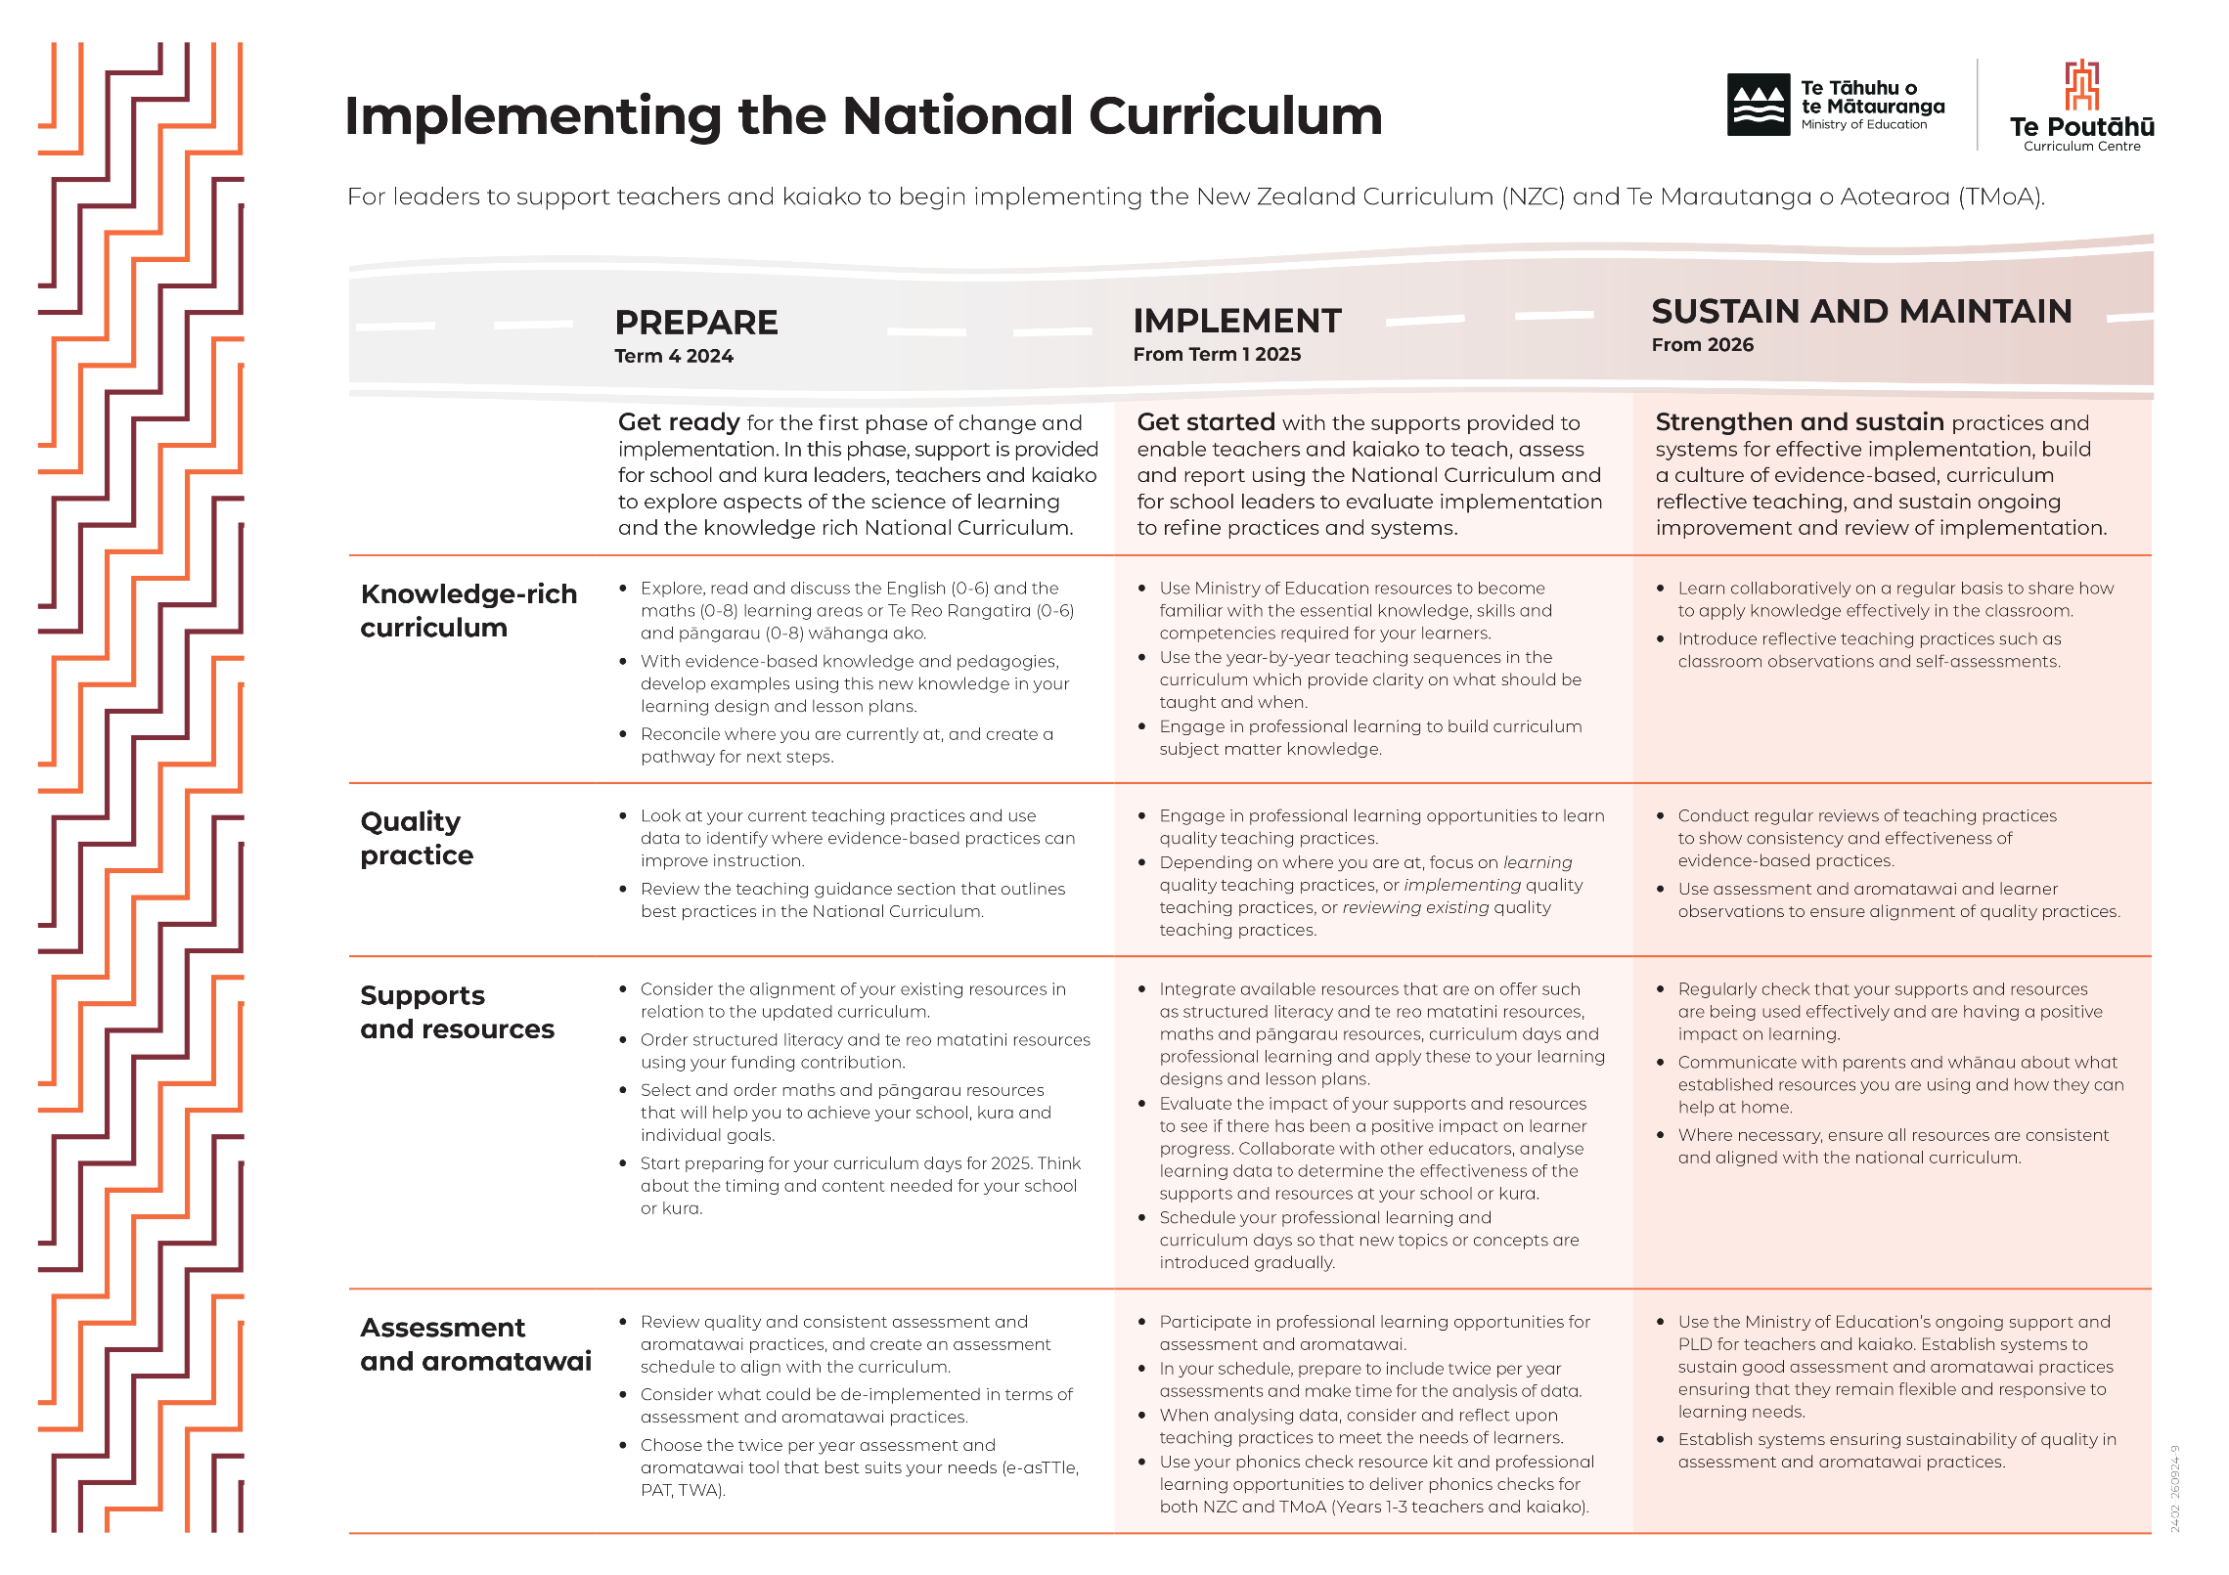
Notes:
The resource pack content and activities are designed to support schools on their implementation journey aligned to actions in the Implementing the National Curriculum to get ready and prepare.

Slide 5
Implementation Timeline Supports for implementing curriculum and assessment changes
The New Zealand Curriculum
Learning areas
2024
2025
2026
2027
English
(Years 0-6)
(Years 7-13)
Mathematics and statistics
(Years 0-8)
(Years 9-13)
Science
Technology
Health and physical education
Learning languages
The Arts
Social sciences
Available for feedback and use
Required
Notes:
In Term 1, 2025
Actions for principals and boards are captured in the ‘Getting Ready, Getting Started’ product:
Supports for implementing curriculum and assessment changes
Schools and kura should:
use the new content for Years 0-6 English and Years 0-8 mathematics and statistics and continue to participate and/or register for structured literacy PLD – check out the ‘how we’re supporting you’ section for more details
use the new teaching resources – e.g. decodables, flashcards, teacher handbooks, student workbooks you have chosen
begin to use the new curricula and teaching practice expectations to underpin your approaches to assessment, aromatawai and reporting in 2025 – we’ve included more information on assessment and aromatawai below
get familiar with the assessment tools including the phonics checks and twice-yearly testing for Years 3-8 using standardised tools to understand learners’ progress.

Slide 6
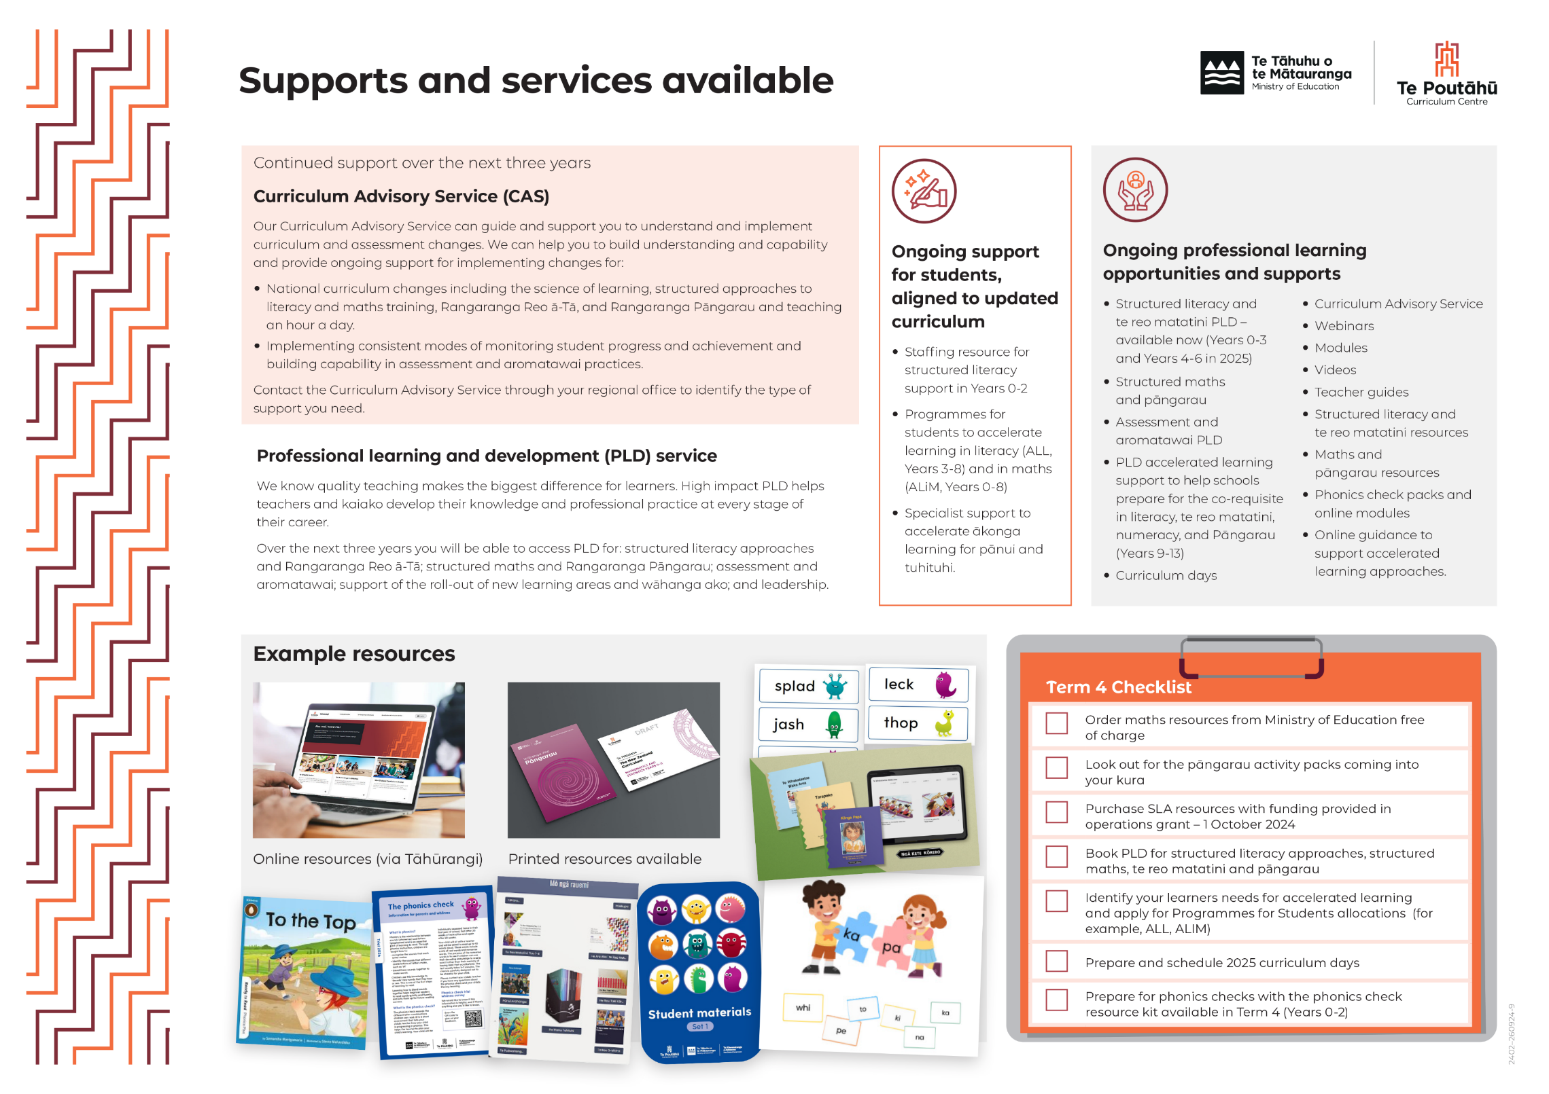
Notes:
Further resources can be found on Tāhūrangi - New Zealand curriculum

Slide 7

Te Mātaiaho |The New Zealand Curriculum – Case for Change
Why for change ….
Lifting progress and achievement:
underpinned by the science of learning
knowledge rich
inclusive of evidence informed teaching practices
clear and easy to use
internationally comparable
supporting the development of key competencies
Notes:
Our work with you over the last few years has helped us to reach important milestones on the road to strengthening our national curriculum for schooling (New Zealand Curriculum).
Thanks to valuable input from the education sector, we have been able to shape the content for recently released revised learning areas for English years 0-6 and mathematics years 0-8 so they now include evidence-based teaching practices and year-by-year sequences. These inclusions respond to calls from teachers, kaiako and leaders for a curriculum and supports that are clearer, more consistent, and easier to use and access.
The Government has prioritised the implementation of these learning areas and rephasing other areas. This decision supports the focus on lifting progress and achievement in these foundational areas which are so important for all learning.
All students are expected to develop knowledge from local, national and global contexts. Therefore, when thinking about local and national contexts, some of this knowledge will be mātauranga Māori. People can expect to see evidence of this in the revised NZC framework which will be available for feedback and use next year.
The revised curriculum:
1. Drawing on cognitive psychology neuroscience & educators research - the curriculum builds on understandings of how we learn from the science of learning
2. Knowledge-rich - prioritises and explicitly describes the teaching that must be taught each year.
Coherent across Learning Area within a phase
Sequenced - to enable students to build knowledge, skills and competencies systematically over time.
3. Clear for teachers - it supports teachers to design teaching and learning programmes that bring it to life in the classroom, through local, national and global contexts.
- clear for schools- their obligations
4. Internationally comparable - use of OECD/PISA/PIRLS/TIMSS jurisdiction
Education Minister Erica Stanford has outlined six education priorities to deliver a world-leading education system that sets Kiwi kids up for future success.
“I’m putting ambition, achievement and outcomes at the heart of our education system. I want every child to be inspired and engaged in their learning so they can achieve to the best of their ability and gain skills and qualifications that will support them into further study and employment,” Ms Stanford says.
“Children and young people at school today are New Zealand’s future. Receiving a world-leading education not only sets children up for success, it sets New Zealand up for success – economically and socially.
“But our declining achievement statistics clearly show that the school system is not delivering for all students. To turn this around, we need to make fundamental changes, including getting back to basics.”
Our Government’s six education priorities:
Clearer curriculum: Establishing a knowledge-rich curriculum grounded in the science of learning.
Better approach to literacy and numeracy: Implementing evidence-based instruction in early literacy and mathematics.
Smarter assessment and reporting: Implementing consistent modes of monitoring student progress and achievement.
Improved teacher training: Developing the workforce of the future, including leadership development pathways.
Stronger learning support: Targeting effective learning support interventions for students with additional needs.
Greater use of data: Using data and evidence to drive consistent improvement in achievement.
“These priorities are focused on lifting achievement and reflect the changes our Government has already made in education, including the requirement to teach one hour a day of reading, writing and maths in primary and intermediate school, and the ban of cell phone use in classrooms,” Ms Stanford says.
“We have set an ambitious target to reach 80 per cent of Year 8 students at or above the expected curriculum level for their age in reading, writing and maths by December 2030.
“Since becoming the Minister, I have met with several Māori education representatives and organisations. Expectations for strengthened educational outcomes and achievement for tamariki and rangatahi Māori is a shared bottom line.
“With that in mind, it is my intention to work collaboratively with Māori education representatives and organisations to develop a Māori education work programme. Initially, the focus will be on enhancing achievement, attendance, engagement.
“For parents, these priorities will give them confidence their children are receiving quality education that will set them up for future success in further study or employment.
“Ultimately this will result in an education system where all students are getting quality learning and skills to succeed no matter where they live, our teachers are supported with a detailed national curriculum parents are aware of their child’s progress, and evidence-based supports and interventions are provided where they are needed.
Narrative – Curriculum and Assessment Updates
Priority 1: Establishing a knowledge-rich curriculum grounded in the science of learning
Since December 2017, the Ministry of Education has been working with the sector to strengthen the National Curriculum to be clear what should be taught, and when, to reduce teacher workload and provide for students to progress and achieve.
Background/historical context for strengthening the national curriculum
An independent Ministerial Advisory Group was established in 2017 and developed recommendations for strengthening curricula.
In 2017, a Ministerial Advisory Group was established in 2017 and developed recommendations for strengthening curricula.
At the time, the curriculum’s flexibility was contributing to variable outcomes across and within schools and kura, potentially burdening teachers who had to act as curriculum designers.
As a result of the flexible 2007 curriculum 2500 schools developed their own varied local curriculum and progressions.
There was not enough clarity on what and how to teach, and what progress learners should have made on a year-by-year basis. There was a need for more granular guidance to reduce teachers’ cognitive load. These issues have resulted in variance in teaching practice and inequitable outcomes across New Zealand.
A decision was made to revised and redesign the National Curriculum (NZ Curriculum and Te Marautanga o Aotearoa) to address these concerns.
We consulted and engaged widely across New Zealand, reflecting a range of voices, including iwi, the sector, peak bodies, academics and experts, groups with learning support needs, organisations and agencies, and the general-public.
For the New Zealand Curriculum (NZC) we developed Te Mātaiaho | The New Zealand Curriculum | The New Zealand Curriculum |the New Zealand Curriculum as a framework, which has been widely consulted on.
Te Mātaiaho | The New Zealand Curriculum | The New Zealand Curriculum |the New Zealand Curriculum is clear the curriculum is national and that teachers and kaiako bring it to full life in the classroom through local, national, and global contexts.
Te Mātaiaho | The New Zealand Curriculum | The New Zealand Curriculum |the New Zealand Curriculum remains as the framework, but with some key changes to make it clearer and easier to use following your feedback, and to work with a knowledge rich, evidence based national curriculum.
The implications of a highly flexible national curricula and the burden on teachers was beginning to show. Results from national and international studies (e.g., NMSSA, PISA, TIMSS and PIRLS) demonstrated persistent inequities and a decade of declining maths and literacy results.
A new independent MAG was appointed in 2023, to review the NZC revised to date, as well as the draft Common Practice Model.
The MAG recommended it would be most useful to have these combined into one document for each curriculum.
That means combining the ed and redesigned knowledge-rich NZC for English Years 0-6 and mathematics and statistics Years 0-8and statistics with the Common Practice Model, and Having this content in one document will provide teachers and kaiako easy access to the information that they need for the “what”, and the “how” of their teaching programmes.

Slide 8
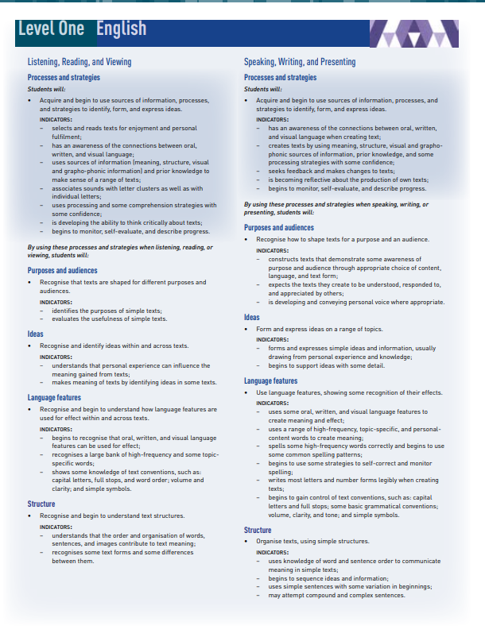
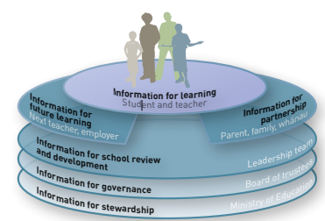

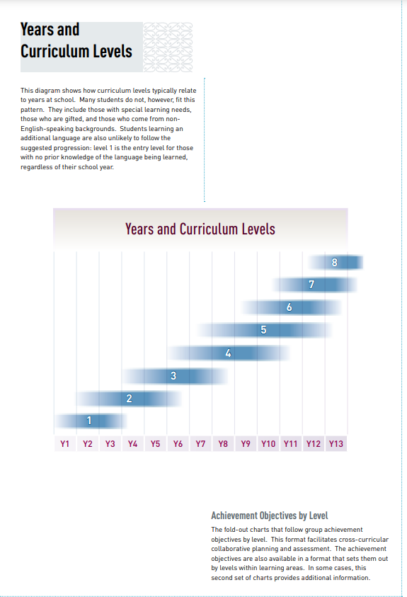
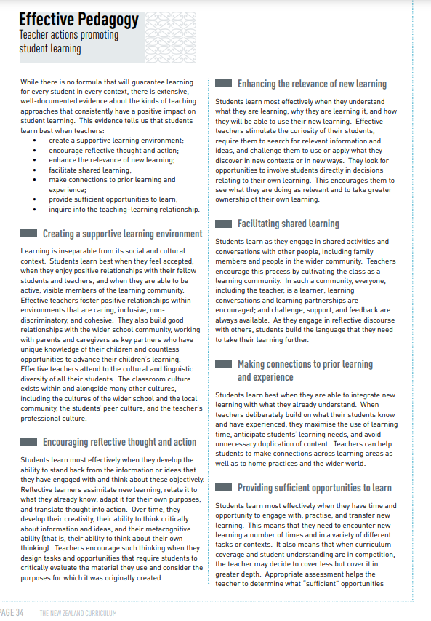
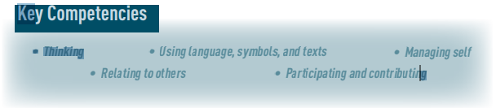
Key changes for clarity and ease of use
Working across parts ….
NZC 2007
Notes:
You will learn how the design of the English Years 0-6 and mathematics and statistics Years 0-8 learning areas, bring clarity and ease of use from the 2007 National Curriculum (slide 5). The New Zealand Curriculum will be knowledge-rich, informed by the science of learning, and framed within the whakapapa of Te Mātaiaho. The structure of the learning areas will provide teachers the clarity of what to teach, when to teach and how, through the approaches that bring knowledge rich learning.
Activity:
Recognise the constraints of working in the current curriculum learning areas: (Slide 4) Reflect on the content of the current 2007 learning areas – How clear and easy to use is the current curriculum? How does the 2007 curriculum show progression in student learning? What guidance does the curriculum offer as to what to teach, when to teach and how to teach?
How would this level of detail be beneficial? And to whom?

Slide 9
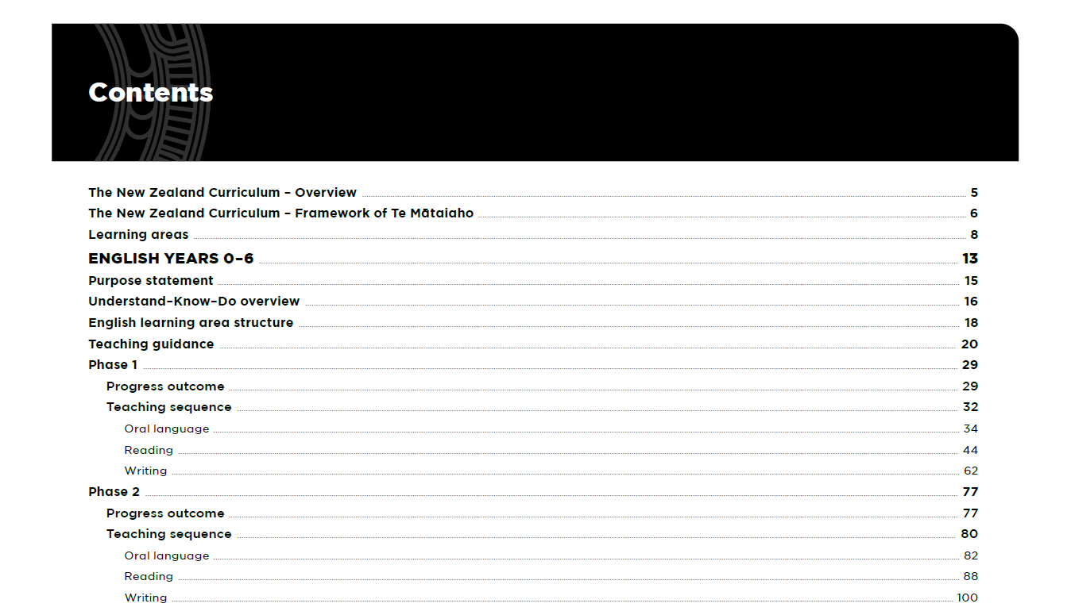
Revised content …knowledge-rich, informed by the science of learning.
Notes:
Help teachers get a sense of familiarity in the content from the drafts of Te Mātaiaho | The New Zealand Curriculum, English Years 0-6 and mathematics and statistics Years 0-8 and Social Sciences
1. progress outcome - UKDs:
Are the signposts at the end of each phase of learning indicating what students
understand, know and can do sufficiently at key points in the schooling pathway.
UKD frames the knowledge students will experience at the end of a phase
Understand – the deep and enduring big ideas and themes that students
develop understanding of over the phases
Know – the meaningful and important content, concepts, and topics at
each phase that enrich students’ understanding of the big ideas and
themes and that students study using the practices
Do – the practices (skills, strategies, and processes) that bring rigour to
learning and support the development of the key competencies.
2. Critical focus for each phase draws on evidence for a sustained, strengths-based, holistic focus
on the student and their social, emotional, and cognitive learning. Each phase has within it a
Years by Years focus which helps with teaching and learning. Each critical focus cumulatively
builds on the phase before.
3. Phases of learning
Facilitator Note: Currently the English learning area is released for Years 0-6 = 2 phases and mathematics and statistics Years 0-8 is released in 3 phases. Other phases will be available for feedback in November 2024 for feedback and use, and required to teach in 2026).
Each learning area will have five phases of learning. Currently English = 2 phases and mathematics and statistics = 3 phases. (other phases will be available for feedback in November 2024 for feedback and use, and required to teach in 2026).
Each phase covers two to three years of school which reflects how most schools orgnaise learning across Years levels (see Learning area content pages 8 & 9 ).
This is a change from NZC 2007 levels – teachers will know what to teach, when to teach and how to teach content for their phase.
Each phase has a progress outcome - UKD describing what students understand, know and can do by the end of the phase. This is a change from NZC 2007 achievement objectives.

Slide 10
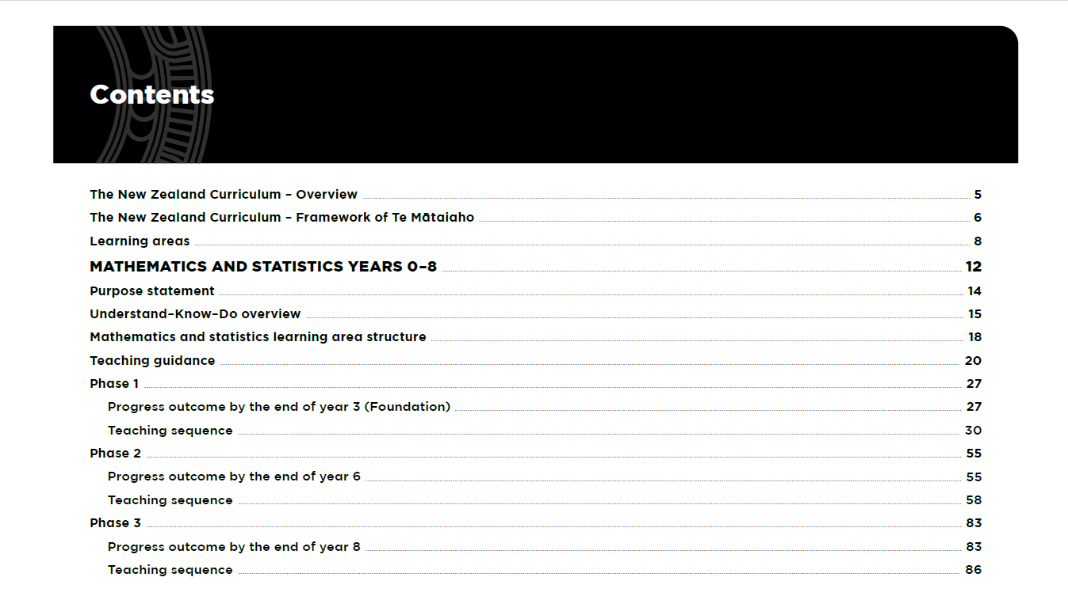
Revised content …knowledge-rich, informed by the science of learning.
….

Slide 11
Notice Te Mātaiaho | The New Zealand Curriculum – knowledge rich, informed by the science of learning and framed within the whakapapa of Te Mātaiaho
Aim:
to notice the key parts in the English Years 0-6 and mathematics and statistics Years 0-8 learning areas
Notes:
Aim: to notice the key updates in the English Years 0-6 and mathematics and statistics Years 0-8 curriculum, to recognise how the science of learning and knowledge-rich approaches are woven together to support student learning, identify benefits to students, teachers, parents, and whānau

Slide 12



Notes:
The revised learning areas sit within the New Zealand Curriculum framework (Te Mātaiaho). The framework will be continued to be refined alongside the development of all learning areas.
People will be able to recognise:
The Understand Know Do (UKD) model
Phases of learning
progress outcome - UKDs
Previously seen elements of the Common Practice Model (CPM)
What’s new:
- Increased teaching guidance and year-by-year teaching sequences to reduce workload on teachers and kaiako and provide clarity on what should be taught and when
NZC and CPM combined into one place
All students are expected to develop knowledge from local, national and global contexts. Therefore, when thinking about local and national contexts, some of this knowledge will be mātauranga Māori. People can expect to see evidence of this in the revised NZC framework.

Slide 13
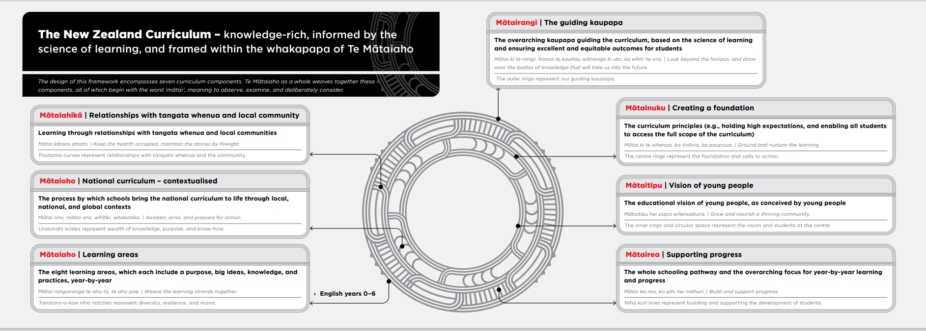
Te Mātaiaho | The New Zealand Curriculum | The New Zealand Curriculum | the New Zealand Curriculum whakapapa
Mātaiaho – house the progression model, essential pedagogies and the learning areas.
Notes:
Te Mātaiaho | The New Zealand Curriculum remains as the framework, but with some key changes to make it clearer and easier to use following your feedback, and to work with a knowledge rich, evidence based national curriculum.
Teachers and kaiako bring Te Mātaiaho | The New Zealand to life in the classroom through local, national, and global contexts.
The design of Te Mātaiaho | The New Zealand Curriculum whakapapa centres around the tohu (signs) that help us navigate our way forward
Mātai means To investigate, scrutinise, gaze into, to observe. Aho means Threads, strands, line of descent, to shine.
You will see that each component of the whakapapa has a different suffix to contextualize it’s intent.
The simple circular design is made up of whakarae (patterns ) that breathe life into the whakapapa and reflect the ideas of observing ,reading the signs, and navigating our way forward.
Mātaiaho –These components house the progression model, evidenced-based practices and the learning areas.
Mātaiaho encompasses the eight learning areas: English, the arts, health and physical education, learning languages, mathematics and statistics, science, social sciences, and technology. Together they provide the basis for a broad, general education for the first four phases Years 0 – 10 and collectively lay a foundation for specialisation in Phase 5 Years 11 – 13. This is the learning that is too important to leave to chance.
All eight learning areas provide students with opportunities for personal enjoyment and satisfaction. They equip students to fully participate in their communities and society, to live confidently and sustainably in the world, and to forge pathways for future study and work.

Slide 14


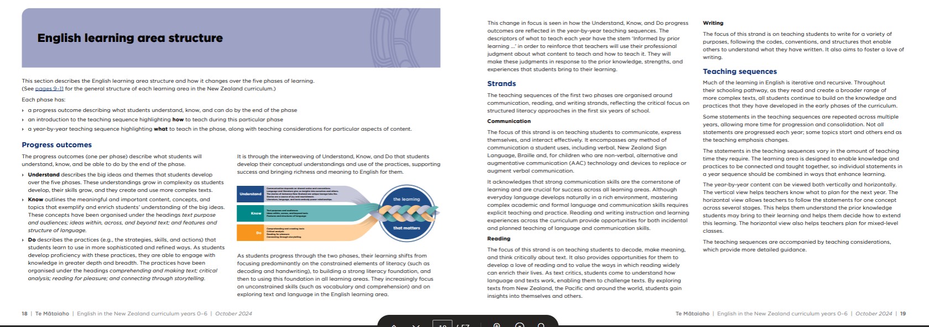




English learning area structure
Consistency of learning area structure
Notes:
Generic changes are explained in “Content of the learning areas” pg. 9
English learning area structure (as above) pg. 18
What they will be familiar with:
1. Progress outcomes:
Are the signposts at the end of each phase of learning indicating what students
understand, know and can do sufficiently at key points in the schooling pathway.
UKD frames the knowledge students will experience at the end of a phase
Understand – the deep and enduring big ideas and themes that students
develop understanding of over the phases
Know – the meaningful and important content, concepts, and topics at
each phase that enrich students’ understanding of the big ideas and
themes and that students study using the practices
Do – the practices (skills, strategies, and processes) that bring rigour to
learning and support the development of the key competencies.
2. Critical focus for each phase draws on evidence for a sustained, strengths-based focus
on the student and their social, emotional, and cognitive learning. Each phase has within it a
Year by Year focus which helps with teaching and learning. Each critical focus cumulatively
builds on the phase before.
3. Phases of learning
Facilitator’s Note: Currently the English learning area is released for Years 0-6 = 2 phases and
mathematics and statistics Years 0-8 is released in 3 phases. Other phases will be available for
feedback in November 2024 for feedback and use, and required to teach in 2026.
Each learning area will have five phases of learning. Currently English = 2 phases and mathematics and statistics = 3 phases. (other phases will be available for feedback in November 2024 for feedback and use, and required to teach in 2026).
Each phase covers two to three years of school which reflects how most schools organise learning across Years levels (see Learning area content pages 8 and 9).
This is a change from NZC 2007 levels – teachers will know what to teach, when to teach and how to teach content for their phase.
Each phase has a progress outcome - UKD describing what students understand, know and can do by the end of the phase. This is a change from NZC 2007 broad achievement objectives.
Draw teachers’ attention to the new parts:
1. The learning areas have added strands and sub strands
Mathematics and statistics now have six strands with several sub-strands (change from NZC 2007 = three). The six strands are found in the ‘Know’ in the progress outcome - UKD (‘knows’ describe the meaningful and important concepts and procedures in mathematics and statistics):
Number
Algebra
Measurement
Geometry
Statistics
Probability
English at phase 1 and 2 has three strands with a number of sub-strands
Oral language (now incorporated within the curriculum)
Reading
Writing
2. Teaching sequence and teaching considerations within each phase
The teaching sequence support teachers to know what to teach, when and how from one progress outcome -UKD to the next.
Teaching considerations of how to teach. While all statements of what to teach are important for student progress the stem ‘Informed by prior learning, teach students to:’ is there to remind teachers to use their professional judgement and use of assessment information to know when to teach what content and how to teach it in response to prior knowledge, strengths, and experiences that students bring.

Slide 15


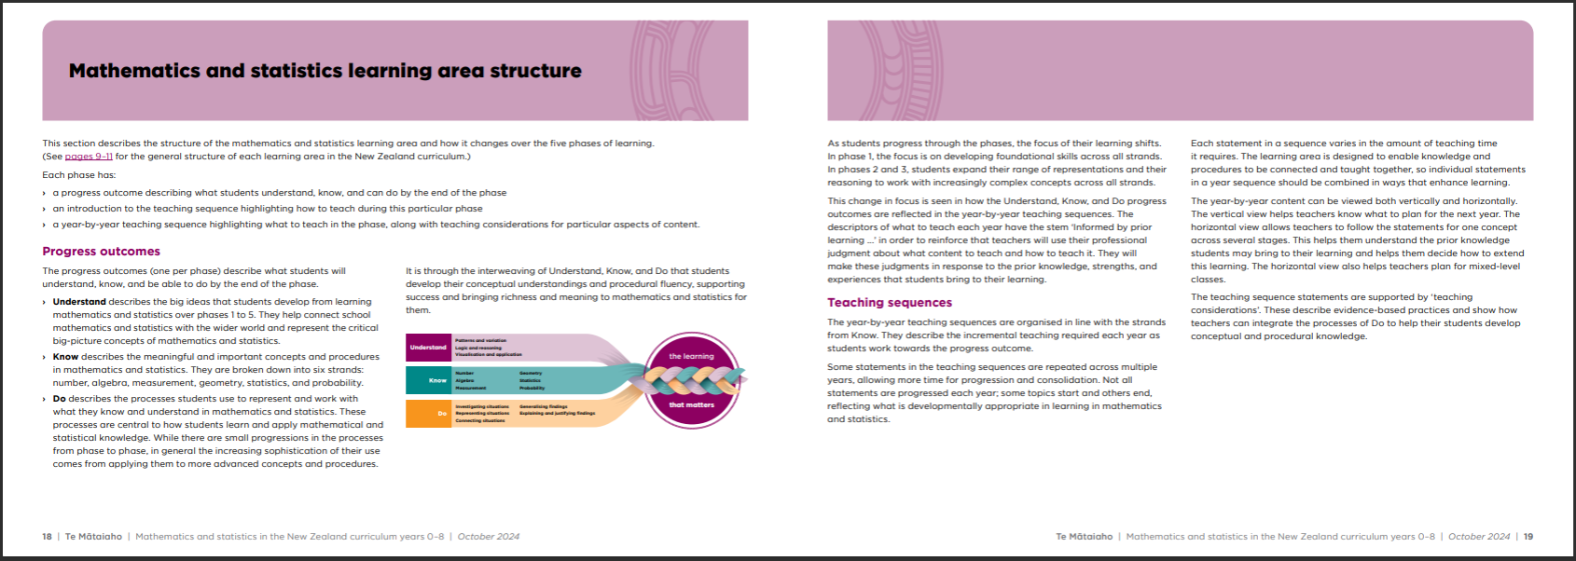


Mathematics & statistics learning area structure
Consistency of learning area structure
Notes:
Generic changes are explained in “Content of the learning areas” pg. 9
maths learning area structure (as above) pg. 18
What they will be familiar with:
1. Progress outcomes:
Are the signposts at the end of each phase of learning indicating what students
understand, know and can do sufficiently at key points in the schooling pathway.
UKD frames the knowledge students will experience at the end of a phase
Understand – the deep and enduring big ideas and themes that students
develop understanding of over the phases
Know – the meaningful and important content, concepts, and topics at
each phase that enrich students’ understanding of the big ideas and
themes and that students study using the practices
Do – the practices (skills, strategies, and processes) that bring rigour to
learning and support the development of the key competencies.
2. Critical focus for each phase draws on evidence for a sustained, strengths-based focus
on the student and their social, emotional, and cognitive learning. Each phase has within it a
Year by Year focus which helps with teaching and learning. Each critical focus cumulatively
builds on the phase before.
3. Phases of learning
Facilitator’s Note: Currently the English learning area is released for Years 0-6 = 2 phases and
mathematics and statistics Years 0-8 is released in 3 phases. Other phases will be available for
feedback in November 2024 for feedback and use, and required to teach in 2026.
Each learning area will have five phases of learning. Currently English = 2 phases and mathematics and statistics = 3 phases. (other phases will be available for feedback in November 2024 for feedback and use, and required to teach in 2026).
Each phase covers two to three years of school which reflects how most schools organise learning across Years levels (see Learning area content pages 8 and 9).
This is a change from NZC 2007 levels – teachers will know what to teach, when to teach and how to teach content for their phase.
Each phase has a progress outcome - UKD describing what students understand, know and can do by the end of the phase. This is a change from NZC 2007 broad achievement objectives.
Draw teachers’ attention to the new parts:
1. The learning areas have added strands and sub strands
Mathematics and statistics now have six strands with several sub-strands (change from NZC 2007 = three). The six strands are found in the ‘Know’ in the progress outcome - UKD (‘knows’ describe the meaningful and important concepts and procedures in mathematics and statistics):
Number
Algebra
Measurement
Geometry
Statistics
Probability
English at phase 1 and 2 has three strands with a number of sub-strands
Oral language (now incorporated within the curriculum)
Reading
Writing
2. Teaching sequence and teaching considerations within each phase
The teaching sequence support teachers to know what to teach, when and how from one progress outcome -UKD to the next.
Teaching considerations of how to teach. While all statements of what to teach are important for student progress the stem ‘Informed by prior learning, teach students to:’ is there to remind teachers to use their professional judgement and use of assessment information to know when to teach what content and how to teach it in response to prior knowledge, strengths, and experiences that students bring.
3. In mathematics and statistics, at the end of each phase, you will find a ‘language of mathematics and statistics’ – see pg. 52, 80 and 100. Teachers will get a sense of the ‘language specific to mathematics’ students will develop within and across the phases of mathematics and statistics.

Slide 16

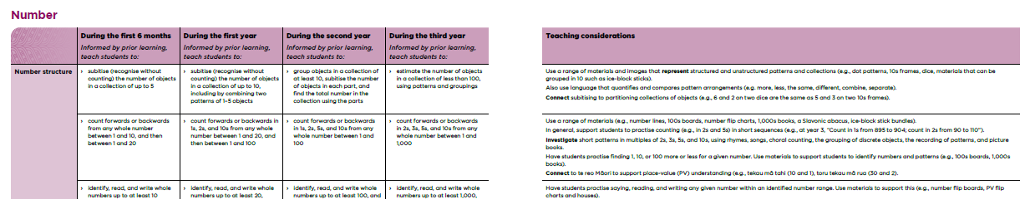
Getting a sense of the revised learning areas: mathematics and statistics
Progress outcome - UKD sets the clarity for teaching and learning
Phase– critical focus of each phase
Phase 1: Teaching sequence
Thriving in environments rich in literacy and maths Te tupu pāhautea i te taiao ako e haumako ana i te reo matatini me te pāngarau
Strand – area to teach
Teaching considerations - how to teach
Stem– responsive teaching
Sequence – when to teach
Sub strand
Cumulative learning of knowledge, skills and competencies over time
Notes:
Get a sense of the revised learning areas……………You will see how the revised learning areas of English Years 0-6 and mathematics and statistics Years 0-8, bring clarity and ease of use to the 2007 National Curriculum through the learning area structure. The New Zealand Curriculum will be knowledge-rich, informed by the science of learning, with the Common Practice Model in the learning areas CPM and framed within the Te Mātaiaho | The New Zealand Curriculum whakapapa.
The New Zealand curriculum is a knowledge-rich curriculum that prioritises and explicitly describes the teaching that must be taught each year.
It is deliberately sequenced to enable students to build knowledge, skills, and competencies systematically over time.
It supports teachers to design teaching and learning programmes that bring it to life in the classroom, through local, national, and global contexts.
Explain that the new parts add the ‘clear and ease of use’ – that is, the planning and teaching guidance year-by-year teaching sequences and the teaching considerations. These have been added to reduce teachers workload by providing clarity on what should be taught, when and how.​
Give teachers a moment to look through the learning areas and add to their ‘wonderings’.
Building from the familiar – the teaching sequence,
familiar with the draft of Te Mātaiaho, note familiarity with the whakapapa, designing from the UKD, progress outcome - UKDs, critical focus that guides designing curriculum from the big ideas, rich contexts, and critical thinking practices.
Say: You may have heard of a Ministry of Education resource that was developed (but not published) last year called the Common Practice Model. It was decided, that instead of having a curriculum (‘the What to teach’) and a separate resource on the ‘How to teach’ that the new learning areas will include key components from the Common Practice Model to provide guidance on the best teaching approaches to use.

Slide 17

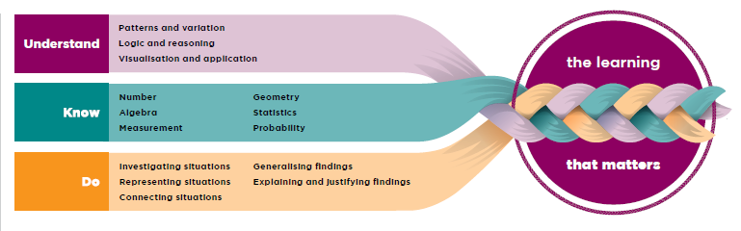
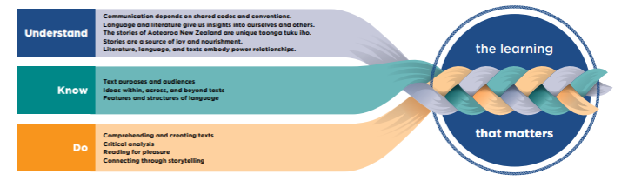

Starting point – building on ….
Building on strength of current practice
Progress outcome - UKD
Mathematics & statistics
English
Social Sciences
Notes:
Progress outcome - UKD – signposts at the end of each phase of learning and indicate what students understand, know and can do sufficiently at key points in the schooling pathway.
Progress outcome - UKD – the knowledge students will experience at the end of a phase
Understand – the deep and enduring big ideas and themes that students develop understanding of over the phases.
Know – the meaningful and important content, concepts, and topics at each phase that enrich students’ understanding of the big ideas and themes and that students study using the practices.
Do – the practices (skills, strategies, and processes) that bring rigour to learning and support the development of the key competencies.

Slide 18

Building on current strengths
Strengths Weakness
Opportunities Threats
Notes:
Create a SWOT graphic organiser (strengths, weaknesses, opportunities, threats analysis tool) on the white board or on large paper of key tactics and approaches teachers mention that were effective to support implementation.
Strengths: Collaboration, resources, shared reading of content, looking for connections and building on what they were already doing, using the progress outcome to ensure the teaching was pitched at the right level, leaders championing the change, attending professional learning sessions and discussions (external or in-school), syndicate-wide planning, having a go, evaluating one’s practice and making changes as you went, … etc.
Weaknesses: What prevented progress? What were the barriers
Opportunities: What opportunities did we look to, learn from, connect from – learning from and connecting from teachers in our Kāhui Ako
Threats: What hindered progress, and how did you work through this?

Slide 19


Implementation forces
Driving forces
Restraining forces
Notes:
Create arrow size to reflect the weight of the force (strong force = wide arrow, weak force, small arrow).

Slide 20
Recognise Mātaiaho | Learning areas Mātai rangaranga te aho tū, te aho pae. | Weave the learning strands together.
Aim: Notice, recognise and respond to the English Years 0-6 and mathematics and statistics Years 0-8& Statistics learning area structure
Notes:
Aim: Notice, recognise and respond to the English Years 0-6 and mathematics and statistics Years 0-8 learning areas.

Slide 21
KWHL – English Years 0-6 and mathematics and statistics Years 0-8 and statistics learning areas
What I already know/do
What I want to find out more about
How can I find out
What I learned
Notes:
Use the K-W-H-L graphic organiser to note teacher reflections after they explore each component of the learning area through this session. K- what we already know/do, W – what do we want to know/do, and who may help, H – how will we approach our new learning, and L - What I learned and what impact has this had on student learning?

Slide 22
The Progression Model
Knowledge-rich progressive learning
Learning Area
Purpose statement
UKD overview
Phase 1 (years 0-3)
progress outcome - UKD
critical focus
Phase 2 (years 4-6)
progress outcome - UKD
critical focus
Phase 3 (years 7-8)
progress outcome - UKD
critical focus
Phase 4 (years 9-10)
progress outcome - UKD
critical focus
Phase 5 (years 11-13)
progress outcome - UKD
critical focus
Teaching sequence
Teaching considerations
Teaching sequence
Teaching considerations
Teaching sequence
Teaching considerations
Teaching sequence
Teaching considerations
Teaching sequence
Teaching considerations
Notes:
The Progression model provides the structure that sequences the knowledge. It supports all students to develop greater:
breadth and depth of knowledge and understanding, through engaging with more complex and ambiguous contexts
refinement and sophistication in their use of competencies, practices, strategies, and processes and skills
ability to connect, transfer, and apply new learning in meaningful contexts
knowledge and awareness of themselves as learners
effectiveness when working with others.
Have teachers Recognise the craft of teaching by weaving the richness of learning using the learning area structure to design rich learning.
The learning areas are organised by:
A critical focus for each phase establishes a sustained, strengths-based, focus on the student and their social, emotional, and cognitive learning at this stage of their schooling journey. Each critical focus builds on the phase before and is reflected in the content of the learning area for the phase.
Purpose statement and UKD overview describing the learning area’s contribution to the lives of students. It is followed by an overview of Understand, Know, and Do. This gives a view of the big ideas, themes, concepts, topics, and practices that underpin the learning area.
Each phase has a progress outcome - UKD describing what students understand, know and can do by the end of the phase
• an introduction to the teaching sequence highlighting how to teach
• a year-by-year teaching sequence highlighting what to teach along with teaching considerations for particular aspects of content
Teaching Guidance: Each learning area draws from the science of learning and wider education theory to provide a knowledge base and guidance for teachers. Teachers use this to help them make purposeful decisions about how to teach the learning area’s content in ways that are inclusive of all students.
The guidance is organised under three headings:
Designing a comprehensive teaching and learning programme
Using assessment to inform teaching
Planning

Slide 23



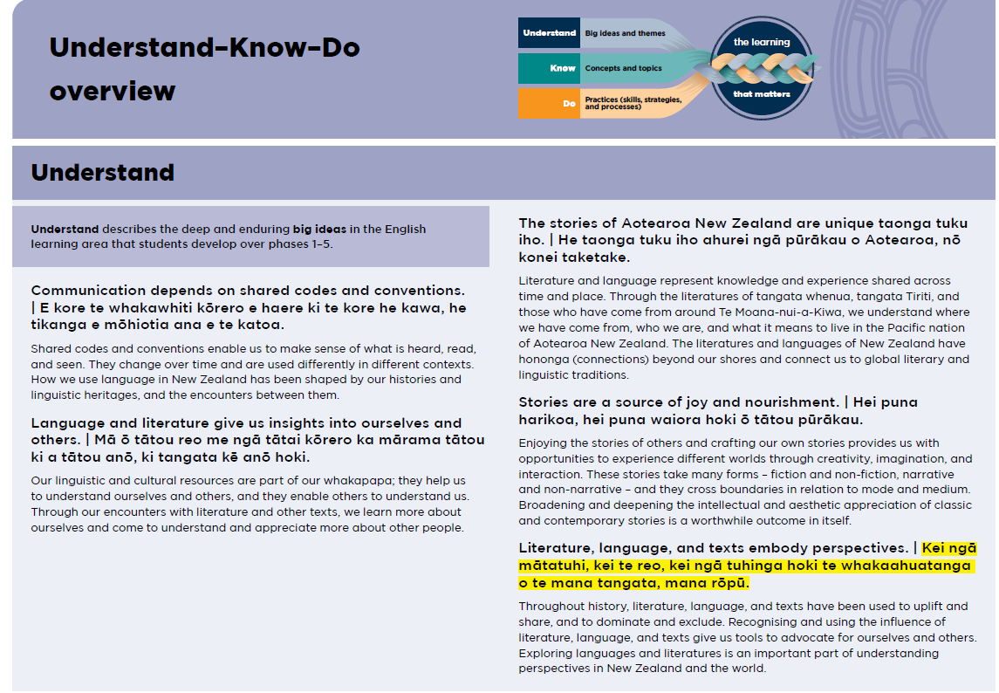
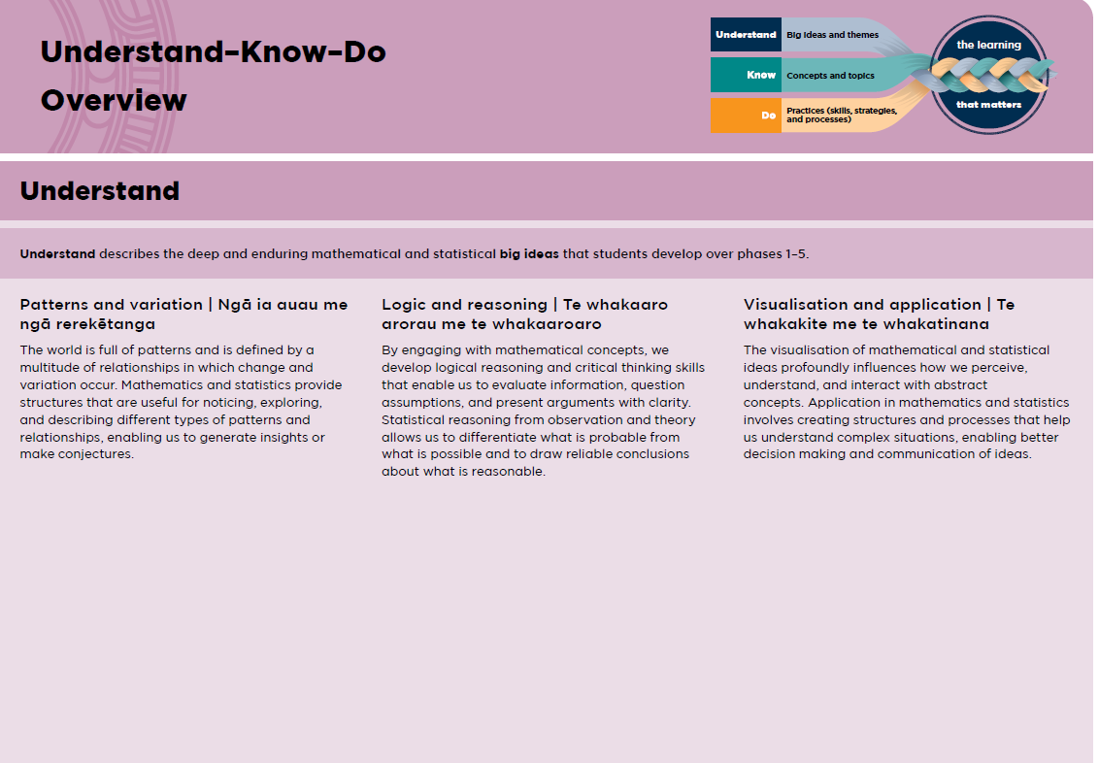
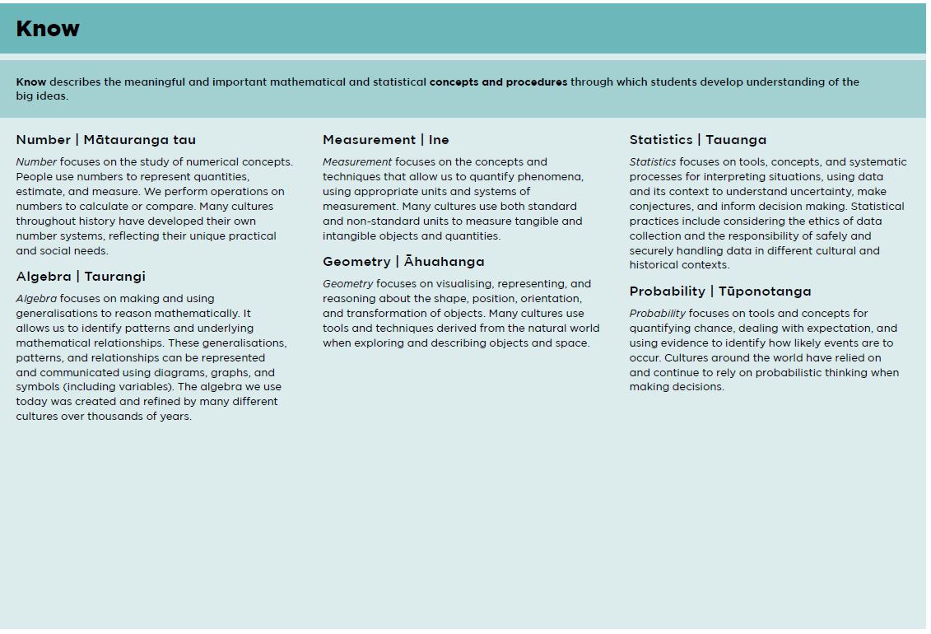
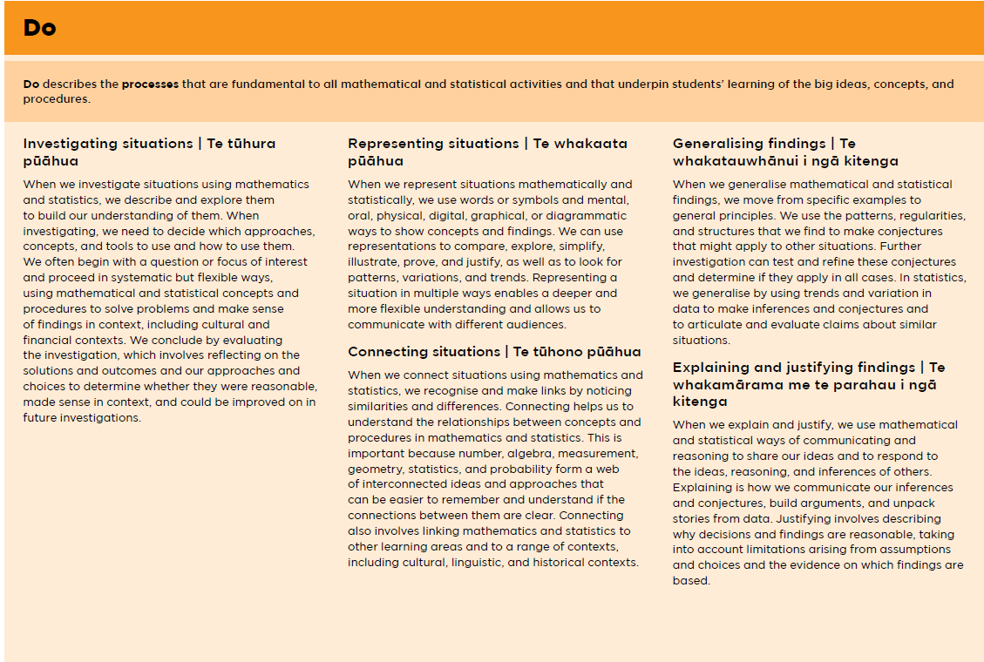
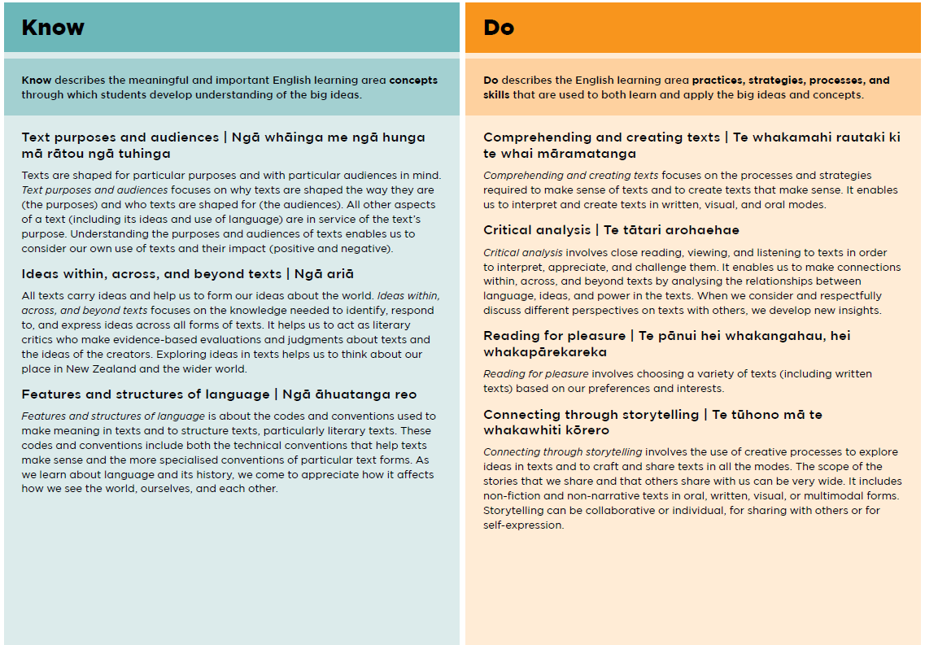
Purpose Statements and UKD Overviews
Purpose statements: - find out the uniqueness and contributions each learning area offers students
UKD Overview:
the worthy rich knowledge the learning area offers students
Notes:
Pg 9 – Learning area document
Each learning area has a purpose statement - the learning area purpose statements describe the unique contributions, the value, and importance of the learning area to the lives of students.
It is followed by an overview of Understand, Know, and Do. This gives a view of the big ideas, themes, concepts, topics and practices that underpin the learning area.
Teachers use the purpose statement and UKD overview to develop an understanding of the learning area, so that they can share its benefits with students.

Slide 24
UKD Quiz
1. Understand | A. The practices (skills, strategies and processes) that bring rigour to learning and support the development of the key competencies
2. Know | B. Enables students to develop the conceptual understanding and procedural fluency within a framework of knowledge and processes that enables success and brings richness and meaning to mathematics and statistics and English.
3. Do | C. The deep and enduring big ideas and themes that students develop over the phases
4. progress outcome - UKD | D. The meaningful and important concepts and topics described at each year level that enrich students’ understanding of the big ideas and themes and that students develop using the practices
5. Interweaving structure | E. Outlines expectations at the end of a phase
Building on ….
Notes:
Match the titles to the statements

Slide 25
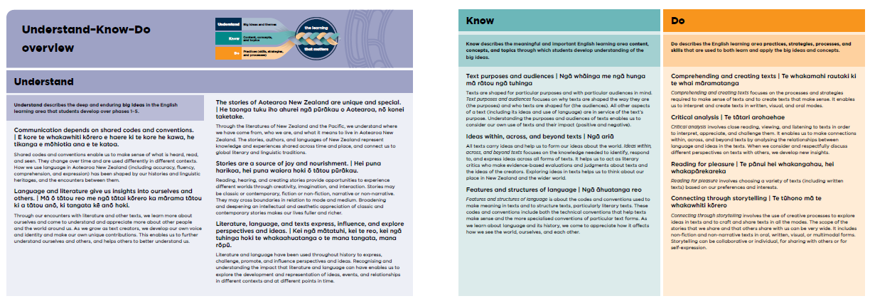
Teachers use the purpose statement and UKD overview to develop an understanding of the learning area benefits to students.
UKD Overview – English Years 0-6
Notes:
The purpose statement and UKD overview support teachers to develop an understanding of the learning area and its intent across the whole schooling pathway, so that they can share with students the benefits and the knowledge they’ll learn.

Slide 26

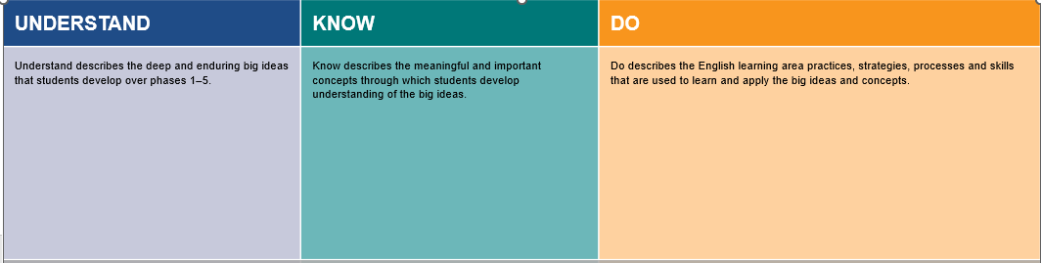
UKD Overview – English year 0-6
Recognise the learning in each phase through the progress outcome –UKD reflecting the critical focus
Notes:
In each learning area, there is one comprehensive progress outcome - UKD for each phase.
The progress outcome - UKDs act as signposts that describe expectations for what students should sufficiently understand, know, and be able to do at key points in the schooling pathway.
The content of each progress outcome - UKD is organised using the Understand–Know–Do framework. While the Understand statements repeat across the five phases, students’ depth of understanding increases as their knowledge of the learning area’s content (Know) grows and their use of the practices (Do) develops.

Slide 27
Progress Outcome - UKD
Understand | The deep and enduring big ideas and themes that students develop over the phases.
Know | The meaningful and important concepts and topics described at each year level that enrich students’ understanding of the big ideas and themes and that students develop using the practices.
Do | The practices (skills, strategies and processes) that bring rigour to learning and support the development of the key competencies.
progress outcome - UKD | Outlines expectations.
Interweaving structure | Enables students to develop the conceptual understanding and procedural fluency within a framework of knowledge and processes that enables success and brings richness and meaning to mathematics and statistics and English.
progress outcome UKD– weaving knowledge, skills and competencies systemically over time
Notes:
UKD quiz answers are 1-C, 2-D, 3-A, 4-E, 5-B

Slide 28
Critical Focus of each phase of learning
The critical desired outcomes of phases
Phase 5 (Years 11-13): | Navigating pathways and developing agency to help shape the future
Phase 4 (Years 9-10): | Having a purpose and being empathetic and resilient
Phase 3 (Years 7-8): | Seeing ourselves in the wider world and advocating with and for others
Phase 2 (Years 4-6): | Having a purpose and being empathetic and resilient
Phase 1 (Years 0-3): | Thriving in environments rich in literacy and maths
Notes:
Use the critical focus cards, (found on page 22 of the facilitation notes) to show critical progressive focus of each phase .
Reflect on your school’s vision and values for your students for depth and breadth of educational outcomes?

Slide 29
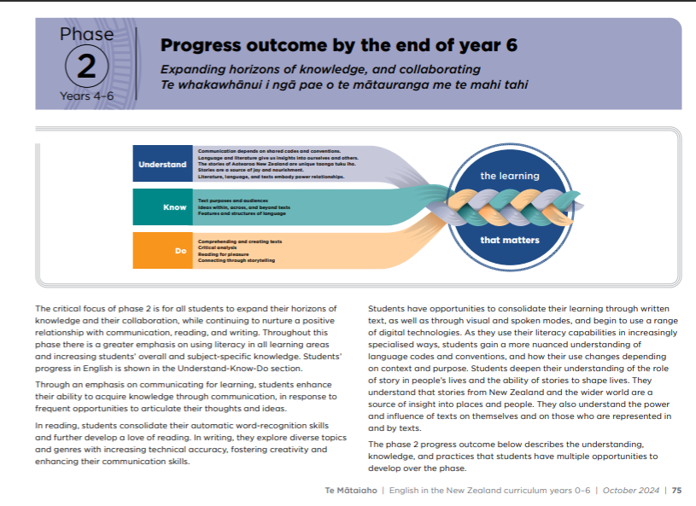
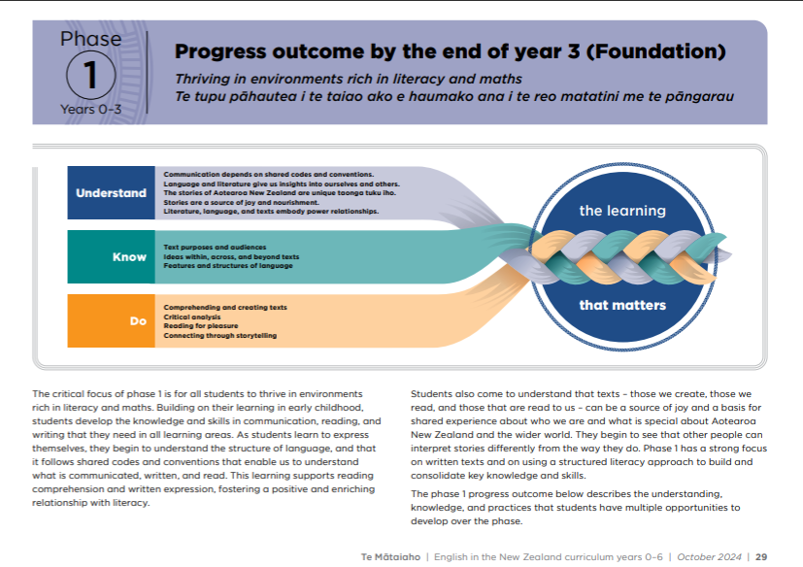
English Years 0-6 Critical Focus
Notes:
In English see how the first 2/5 critical focus cumulatively builds on the phase before.
Have teachers discuss the critical focus – alignment to goals of your learners pathways?

Slide 30
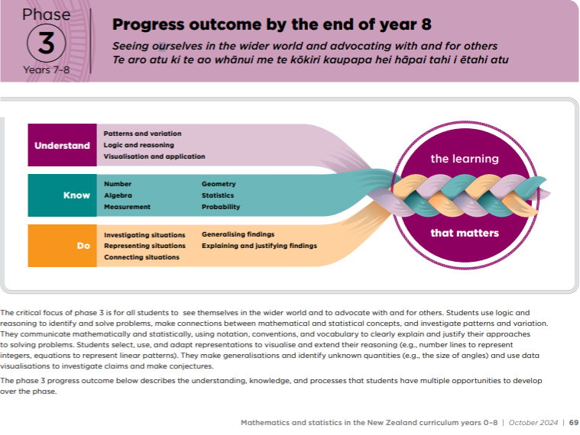
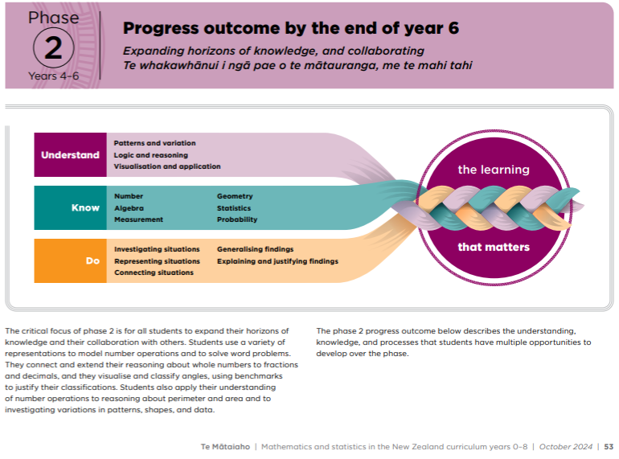
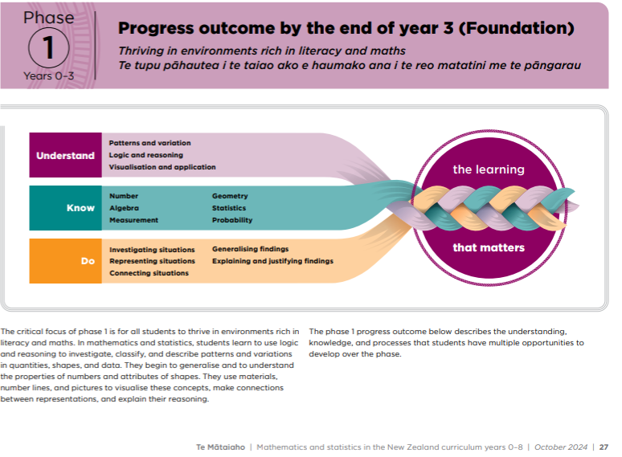
Mathematics and statistics Years 0-8 Critical Focus
Notes:
The critical focus fits across all learning areas - cumulatively builds on the phase before in the first 3 phases.

Slide 31
Learning area structure check in
9.
10
1.
11.
.
2.
3.
4.
5.
6.
7.
8.
A. Informed by science of learning
B. Purpose Statement
C. UKD Overview
D. Learning area
E. Knowledge rich
F. Framed within the whakapapa of Te Mātaiaho | The New Zealand Curriculum | The New Zealand Curriculum |the New Zealand Curriculum
G. Phase 1
outcome - UKD & critical focus
H. Phase 2
outcome - UKD & critical focus
I. Phase 3
outcome - UKD & critical focus
J. Phase 4
outcome - UKD & critical focus
K Phase 5
progress outcome - UKD & critical focus
Notes:
Facilitators note:
Quick check in quiz
Match the letters of the box to the box number

Slide 32
Learning area structure
9.Framed within the whakapapa of TeMātaiaho
10. Knowledge-rich
1. Learning area
11. Informed by the science of learning
2. Purpose statement
3. UKD Overview
Phase 1
progress outcome-UKD & critical focus
Phase 2
Progress outcome - UKD & critical focus
Phase 3
progress outcome - UKD & critical focus
Phase 4
progress outcome - UKD & critical focus
Phase 5
progress outcome - UKD & critical focus
Notes:
Answers to the learning area quiz

Slide 33
Getting a sense of the revised learning areas: mathematics and statistics
Progress outcome - UKD sets the clarity for teaching and learning
Phase– critical focus of each phase
Phase 1: Teaching sequence
Thriving in environments rich in literacy and maths Te tupu pāhautea i te taiao ako e haumako ana i te reo matatini me te pāngarau
Strand – area to teach
Teaching considerations - how to teach
Stem– responsive teaching
Sequence – when to teach
Sub strand
Cumulative learning of knowledge, skills and competencies over time
Notes:
Get a sense of the revised learning areas……… The content of a learning area within a phase.

Slide 34
Respond To Content of the Learning area
Aim:
Explore and respond to the evidence-based teaching strategies that align with the teaching guidance and sequences for English Years 0-6 and mathematics and statistics Years 0-8, ensuring clarity on what, when, and how to teach.
Recognise how the teaching guidance inform decisions that design rich, engaging, and inclusive learning experiences, fostering essential knowledge, skills, and capabilities
Content of the Learning area
Notes:
Aim: Explore and apply evidence-based teaching strategies that align with the teaching guidance and sequences for English years 0-6 and mathematics and statistics years 0-8, ensuring clarity on what, when, and how to teach.
Recognise how the teaching guidance inform decisions that design rich, engaging, and inclusive learning experiences, fostering essential knowledge, skills, and capabilities

Slide 35

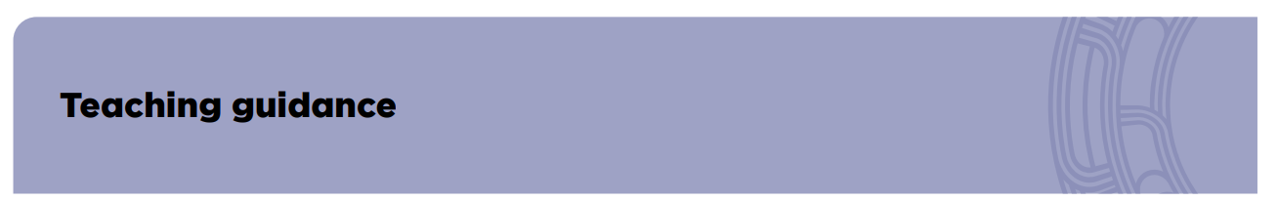
Designing and delivering effective teaching and learning programmes
We learn best when we experience a sense of belonging in the learning environment and feel valued and supported
A new idea or concept is always interpreted through, and learned in association with, existing knowledge.
Establishing knowledge in a well-organised way in long-term memory reduces cognitive load and allows the knowledge to be applied and transferred.
Our social and emotional wellbeing directly impacts on our ability to engage in learning.
Motivation is critical for engagement in learning and wellbeing
Notes:
The teaching guidance highlights the characteristics that come from scientific understanding, inform how people learn. Teachers use this to help them make purposeful decisions about how to teach the learning area’s content in ways that are inclusive of all students.

Slide 36
Planning guidance
Planning considerations across learning areas
Inclusive teaching and learning.
Using assessment information to guide planning.
Sequencing units to build on prior knowledge.
Integrating content strands or skills to create a cohesive programme.
Ensuring opportunities to revisit and consolidate learning.
Balancing explicit teaching with rich tasks that promote problem-solving and application
Year plan
Unit plan
Week plan
Reflect
Reflect
Notes:
The planning guidance for both English Years 0-6 and mathematics and statistics Years 0-8 shares some common elements while also having specific differences unique to each learning area. These elements reflect the characteristics and evidence-based practices embedded in the learning areas for delivering rich, inclusive, engaging, and effective learning experiences.

Slide 37
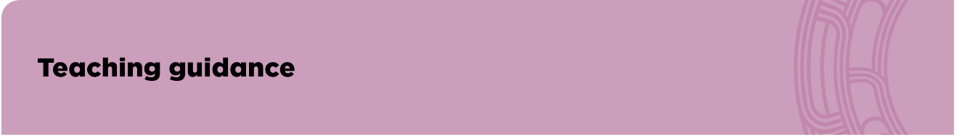

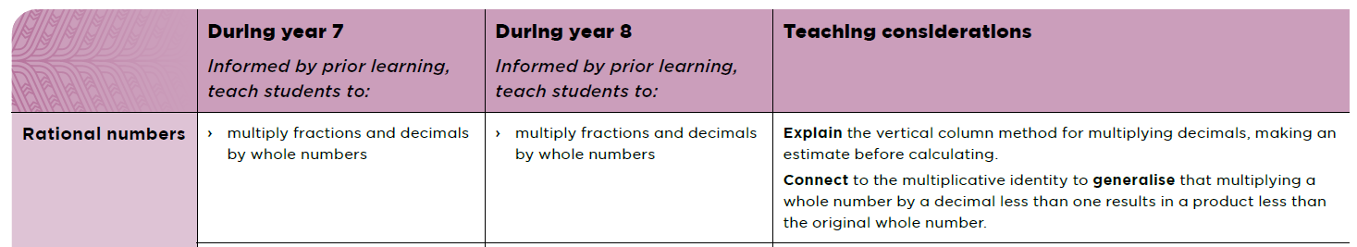
Developing a Comprehensive Teaching and Learning Programme
Teacher decision making when designing a comprehensive teaching and learning programme.
Notes:
The teaching and planning guidance comes to life through the decisions teachers make when designing a comprehensive teaching and learning programme. Each phase has an introduction to the teaching sequence highlighting how to teach with the elements specific to the phase.
The sequence statements which reminds teachers to use their professional judgement and assessment information when selecting what content to teach.
The teaching considerations help teachers to know ‘how to teach’ this content in response to students’ prior knowledge, strengths, and experiences.

Slide 38

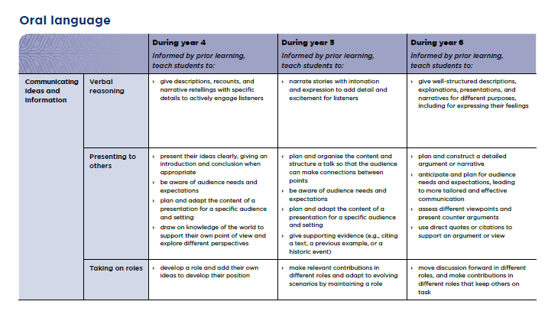
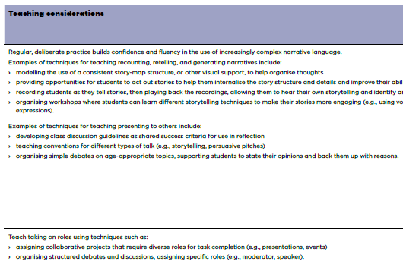
Teaching sequence
Phase– critical focus
Recognise the organisation of statements to revisit ideas …
Strand – area to teach
Stem– responsive teaching
Sequence statements
Teaching considerations
Sub strand
Focus area
Notes:
Each phase has a year-by-year teaching sequence. These sequences support teachers to know what to teach and when and how to teach it as students work towards the progress outcome - UKD for the phase. They have been organised to support students to revisit ideas, knowledge, and practices in ways that deepen their learning and enable them to use it at the next phase.
The sequence shows each strand, organised into substrands and focus areas. For example here we can see Oral language, the sub strand communicating ideas and information and the focus area presenting to others.

Slide 39
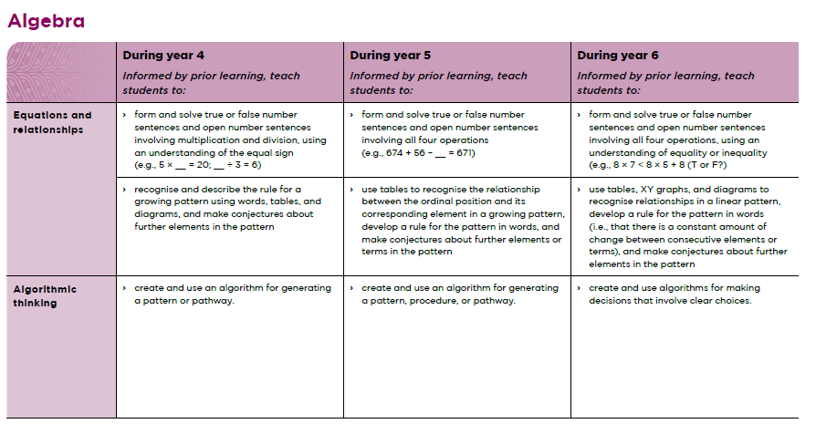
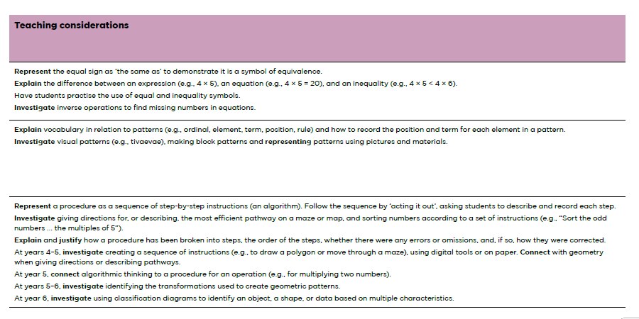
The two parts in a teaching sequence
In response to students’ prior knowledge, strengths, and experiences.
Sequence – what and when to teach
Teaching considerations - how to teach
Notes:
There are two parts in a teaching sequence: statements of what to teach, and ‘teaching considerations’ for how to teach:
the ‘what to teach’ statements are preceded by the stem ‘Informed by prior learning ...’, which reminds teachers to use their professional judgement and assessment information when selecting what content to teach
the teaching considerations help teachers to know ‘how to teach’ this content in response to students’ prior knowledge, strengths, and experiences.

Slide 40
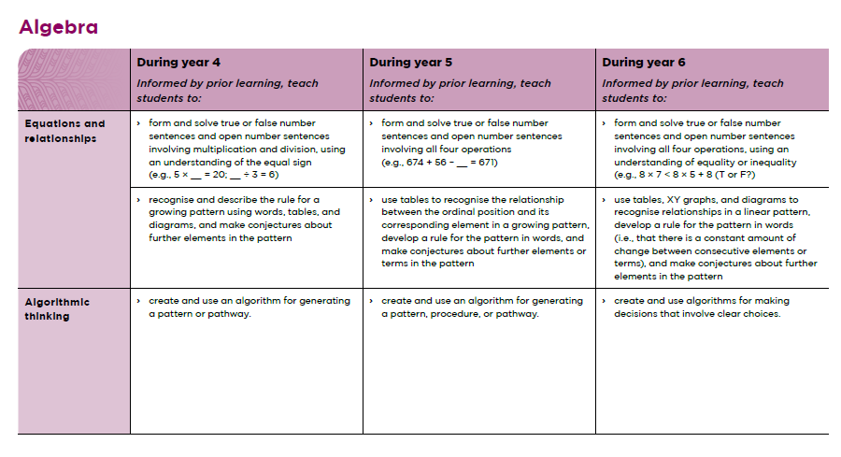
View the teaching sequence, vertically and horizontally
Planning for a year level and recognising prior learning
Notes:
The teaching sequence, which describes what should be taught in each year of the phase. View the phase sequence both vertically and horizontally. Looking down the columns helps teachers know what to plan for a year level. Looking across the rows at the statements for the same concept in the preceding and following years helps teachers to recognise prior learning that students may come with and to consider what the next steps in learning will be. It also helps teachers in taking a view of their students’ progress , and it is a strong support when planning for mixed level classes.

Slide 41
Reflection – Preparing for implementation

Slide 42
KWHL – English Years 0-6 and mathematics and statistics Years 0-8& statistics learning areas
What I already know/do
What I want to find out more about
How can I find out
What I learned

Slide 43

The New Zealand curriculum is knowledge-rich. It prioritises and explicitly describes what must be taught each year and is deliberately sequenced to enable students to build knowledge, skills, and competencies systematically over time. It supports teachers to design teaching programmes that bring learning to life in the classroom, using local, national, and global contexts. The science of learning informs curriculum sequencing and teaching practice.
Te Mātaiaho | The New Zealand Curriculum page 5

Slide 44


Teacher focussed
The new parts that support the great work you do every day
The benefits of a curriculum grounded in the science of learning, empowering teachers with proven strategies to bring the content to life:

Slide 45
Community focussed
The revised curriculum, setting up our kids for success
The benefits of a curriculum grounded in the science of learning, empowering teachers with proven strategies to bring the content to life.
Notes:
We want all children to achieve their potential no matter where they are.
Key to this are strong foundational skills in reading, writing, and maths. These skills enable them to be successful in the broader curriculum learning at school and gain qualifications into further study and employment. This will open doors to fulfilling careers and empower our children to navigate the world confidently.
Teachers and schools are supported by a detailed, knowledge-rich curriculum and will know what needs to be taught and when.
All students will be learning literacy and mathematics in a way that evidence tells us best supports students to learn.
Parents will know about their child’s progress and teachers will know about their students’ progress so they can adjust as needed.

Slide 46
Additional implementation supports for English Years 0-6 and mathematics & statistics Years 0-8 learning areas
Videos are available with useful information to support you in exploring the learning areas.

Slide 47
Supports

